Slide 1
CS 4530: Fundamentals of Software Engineering Module 5: Interaction-Level Design Patterns
Adeel Bhutta, Joydeep Mitra, and Mitch Wand
Khoury College of Computer Sciences
© 2025 Released under the CC BY-SA license
Notes:
This is lesson 5, the Interaction Scale.

Slide 2
Learning Goals for this Lesson
By the end of this lesson, you should be able to
Explain how patterns capture common solutions and tradeoffs for recurring problems.
Explain and give an example of each of the following:
The Demand-Pull pattern
The Data-Push (aka Listener or Observer) pattern
The Callback or Handler pattern
The Typed-Emitter pattern
Notes:
<read slide>

Slide 3
What is a Pattern?
A Pattern is a summary of a standard solution (or solutions) to a specific class of problems.
A pattern should contain
A statement of the problem being solved
A solution of the problem
Alternative solutions
A discussion of tradeoffs among the solutions.
For maximum usefulness, a pattern should have a name.
So you can say “here I’m using pattern P” and people will know what you had in mind.

Slide 4
Patterns help communicate intent
If your code uses a well-known pattern, then the reader has a head start in understanding your code.

Slide 5
Patterns are intended to be flexible
We will not engage in discussion about whether a particular piece of code is or is not a “correct” instance of a particular pattern.

Slide 6
This week we will talk about the interaction scale
The Structural Scale
key questions: what are the pieces? how do they fit together to form a coherent whole?
The Interaction Scale
key questions: how do the pieces interact? how are they related?
The Code Scale
key question: how can I make the actual code easy to test, understand, and modify?
Notes:
This week we will be talking about the interaction scale: how do the pieces interact? (Don’t worry: we will eventually talk about design at the structural scale, but not for a while).

Slide 7
Example: Interface for a simple clock
src/pullingClock/IPullingClock.ts
export default interface IPullingClock {
/** sets the time to 0 */
reset():void
/** increments the time */
tick():void
/** getter that returns the current time */
get time():number
}
Notes:
Let’s take a look at a concrete example. Here is the interface for a simple clock. Here we've used the typescript convention to specify that 'time' is a getter.
It has three methods: reset, tick, and time. Note that the interface includes a description of what each method is supposed to do. This is part of the "make your Data Mean Something" pattern we talked about last time.

Slide 8
Tests for the clock and the client describe their desired behavior
import { SimpleClock, ClockClient } from "./simpleClock"
test("test of SimpleClock", () => {
const clock1 = new SimpleClock
expect(clock1.time).toBe(0)
clock1.tick()
clock1.tick()
expect(clock1.time).toBe(2)
clock1.reset()
expect(clock1.time).toBe(0)
})
test("test of ClockClient", () => {
const clock1 = new SimpleClock
expect(clock1.time).toBe(0)
const client1 = new ClockClient(clock1)
expect(clock1.time).toBe(0)
expect(client1.clientTime()).toBe(0)
clock1.tick()
clock1.tick()
expect(client1.clientTime()).toBe(2)
})
src/pullingClock/simpleClockUsingPull.test.ts
Notes:
Remember we're doing test-driven development, so here some simple tests that describe the desired behavior of our clock. And while we're at it, we should think about a client of the clock, and write tests for *its* expected behavior.
Here’s a little testing script, in Jest.

Slide 9
simpleClockUsingPull.ts
src/pullingClock/simpleClockUsingPull.ts
import IClock from "./IPullingClock";
export class SimpleClock implements IClock {
private _time = 0
public reset() : void {this._time = 0}
public tick() : void { this._time++ }
public get time(): number { return this._time }
}
export class ClockClient {
constructor (private theclock:IClock) {}
clientTime(): number {return this.theclock.time}
}
SimpleClock is the Producer
ClockClient is the Consumer
Notes:
Now, let's implement IClock, and a ClockClient that uses it. SimpleClock is the producer, and ClockClient is the consumer.
Notice that constructor says “theclock:IClock”, because this client depends only on the fact that ‘theclock’ obeys the specification of IClock. If it had said "theclock:SimpleClock" then the compiler would reject any attempt to build a ClockClient using any other implementation of IClock.

Slide 10
We call this the "demand-pull" pattern
because the when the client needs some data, it pulls the data it needs from the server.
Alternative names: you could call these the consumer and the producer.

Slide 11
But there's a potential problem here.
What if the clock ticks once per second, but there are dozens of clients, each asking for the time every 10 msec?
Our clock might be overwhelmed!
Can we do better for the situation where the clock updates rarely, but the clients need the values often?

Slide 12
The 'data-push' pattern
We'd like to arrange it so that the server pushes the data to the consumer only when it changes
To accomplish that, the consumer needs to advertise an 'update' method that the producer can call.

Slide 13
This is called the Listener or Observer Pattern
Also called "publish-subscribe pattern"
The object being observed (the “subject”) keeps a list of the objects who need to be notified when something changes.
subject = producer = publisher
When a new object (i.e., the “consumer”) wants to be notified when the subject changes, it registers with ("subscribes to") the subject/producer/publisher
observer = consumer = subscriber = listener
Notes:
When there is more than one consumer, this is typically called the Observer Pattern, or the Publish-Subscribe Pattern, or the Listener Pattern.
<read slide>
Let’s see how this works, in more detail.

Slide 14
Interface for a clock using the Push pattern
src/pushingClock/pushingClock.interface.ts
export interface IPushingClock {
/** resets the time to 0 */
reset():void
/**
* increments the time and sends a .notify message with the
* current time to all the consumers
*/
tick():void
/** adds another consumer and initializes it with the current time */
addListener(listener:IPushingClockClient):number
}
Notes:
Here is an interface for a clock using the Push pattern.
<Go through methods>
The description of `addListener` tells us that a clock may have more than one consumer or listener.
A more complete description might mention that the clock can handle some maximum number of consumers, but we don’t care about that here.
Note that we specify that the listeners/consumers/observers are notified by sending them a notify message with the current time. If we didn’t specify this, we wouldn’t know how to write a listener.

Slide 15
Interface for a clock listener
src/pushingClock/pushingClock.interface.ts
interface IPushingClockClient {
/**
* * @param t - the current time, as reported by the clock
*/
notify(t:number):void
}
Notes:
And here’s the matching interface for a clock listener. Note that we’ve put semantics in the interface– we say that the notify method expects to receive a message with the current time.
This semantic information completes the contract between the producer and the consumer– it’s not enough to know the names of the relevant methods; we need to know what is in the message.
Of course, an actual client will have other behavior!

Slide 16
Tests
src/pushingClock/pushingClock.test.ts
test("single observer", () => {
const clock1 = new PushingClock()
const observer1
= new PushingClockClient(clock1)
expect(observer1.time).toBe(0)
clock1.tick()
clock1.tick()
expect(observer1.time).toBe(2)
})
test("Multiple Observers", () => {
const clock1 = new PushingClock()
const observer1
= new PushingClockClient(clock1)
const observer2
= new PushingClockClient(clock1)
const observer3
= new PushingClockClient(clock1)
clock1.tick()
clock1.tick()
expect(observer1.time).toBe(2)
expect(observer2.time).toBe(2)
expect(observer3.time).toBe(2)
})
Notes:
Here are some tests that illustrate the expected behavior of this system.
On the left-hand side, we test to see that everything works with a single observer. First we create a clock. Then we create a client, telling it to get its time from the clock we just created. We check that the client starts at time 0. We tick the clock twice, and then check to see that the client shows time equals 2.
On the right-hand side, we do the same thing with multiple observers. We create 3 observers, telling them all to register with the same clock. Again, we tick the clock twice, and check to see that all 3 observers show the correct time.

Slide 17
A PushingClock class
src/pushingClock/pushingClock.ts
export default class PushingClock implements IPushingClock {
private _time = 0
reset() : void { this._time = 0; this.notifyAll() }
tick() : void { this._time++; this.notifyAll() }
private _observers: IPushingClockClient[] = []
public addListener(obs:IPushingClockClient): number {
this._observers.push(obs);
return this._time
}
private notifyAll() : void {
this._observers.forEach(obs => obs.notify(this._time))
}
}
Notes:
Here’s an implementation of IPushingClock. This code keeps a private field ‘observers’ which is a list of the consumers that it needs to notify. It has a private method called ‘NotifyAll’ that calls each observer’s notify method, and when the clock is ticked, it calls notifyAll to actually notify the observers. Similarly, when the clock is reset, it calls notifyAll to notify the observers.

Slide 18
A Client
src/pushingClock/pushingClockClients.ts
export class PushingClockClient implements IPushingClockClient {
private _time:number
constructor (theclock:IPushingClock) {
this._time = theclock.addListener(this)
}
notify (t:number) : void {this._time = t}
get time () : number {return this._time}
}
Notes:
And here’s a client. When such a client is created, it is given the identity of an PushingClock, and it tells that PushingClock to add this client as an observer.
When this client’s notify method is called, it uses the argument of the notify method to set the client’s private clock.
And (surprise!) these methods pass the tests we wrote earlier.

Slide 19
The observer can do whatever it likes with the notification
src/pushingClock/pushingClockClients.ts
export class DifferentClockClient implements IPushingClockClient {
/** TWICE the current time, as reported by the clock */
private _twiceTime:number
constructor (theclock:IPushingClock) {
this._twiceTime = theclock.addListener(this) * 2
}
/** list of all the notifications received */
public readonly notifications : number[] = [] // just for fun
notify(t: number) : void {
this._twiceTime = t * 2
this.notifications.push(t)
}
get time() : number { return (this._twiceTime / 2) }
}
Notes:
Note that the observer gets to decide what to do with the notification. Here’s another client that does something different with the notification. Instead of taking the notification argument t and using it to set the local time, it doubles t. Then, it also keeps a log of the notifications it receives– it doesn’t do anything with the log; it’s just for fun.
If anybody asks for the time, the client takes what it has and divides it by 2. So this code returns the same values for getTime, and it would pass the tests we just saw.

Slide 20
Better test this, too
src/pushingClock/pushingClock.test.ts
test("test of DifferentClockClient", () => {
const clock1 = new PushingClock()
const observer1 = new DifferentClockClient(clock1)
expect(observer1.time).toBe(0)
clock1.tick()
expect(observer1.time).toBe(1)
clock1.tick()
expect(observer1.time).toBe(2)
})
Notes:
And here are the tests for this client. But wait, this client has other behaviors, which we should test.

Slide 21
Tests for .notifications method
test("DifferentClockClient accumulates the times correctly", () => {
const clock1 = new PushingClock()
clock1.tick()
const differentClient = new DifferentClockClient(clock1)
expect(differentClient.time).toBe(1)
expect(differentClient.notifications).toEqual([])
clock1.tick()
clock1.tick()
clock1.tick()
expect(differentClient.time).toBe(4)
expect(differentClient.notifications).toEqual([2, 3, 4])
})
src/pushingClock/pushingClock.test.ts
There are more tests in here;
you should look at them.
Notes:
Here we've also tested what happens when the client joins the clock after it starts (not just when the clock's value is 0!). We observe that the reported time is correct, and the list of notifications is [2,3,4] (not including the time 1, which occurred before the client joined the clock).

Slide 22
Push or Pull?
more data requests
data changes slowly;
prefer to push on change
data changes faster;
prefer to only pull when needed
data changes faster

Slide 23
Push vs. Pull: Tradeoffs
PULL | PUSH
The Consumer knows about the Producer | Producer knows about the Consumer(s)
The Producer must have a method that the Consumer can call | The Consumer must have a method that producer can use to notify it
The Consumer asks the Producer for the data | Producer notifies the Consumer whenever the data is updated
Better when updates are more frequent than requests | Better when updates are rarer than requests
Notes:
Here’s a side-by-side comparison of the tradeoffs.
Note that if the data is changing rapidly, but the consumer only asks for it rarely, then Pull is better because it leads to less traffic.
Similarly, if the data is changing slowly, but the consumer needs it often, the Push is better because that leads to less traffic.

Slide 24
Details and Variations
How does the consumer get an initial value?
Here we’ve had the producer supply it when the consumer registers
Should there be an unsubscribe method?
What data should be passed with the notify message?
this should be specified in the interface
Might there be several kinds of notifications?
leads to the emitter pattern
Notes:
There are lots of details and variations to work out here. <read slide> It all depends on the application in which we are using the pattern.

Slide 25
Maybe the server doesn't want to give the client access to all of its methods
export class DifferentClockClient implements IPushingClockClient {
/** TWICE the current time, as reported by the clock */
private twiceTime:number
constructor (theclock:IPushingClock) {
this.twiceTime = theclock.addListener(this) * 2
}
/** list of all the notifications received */
public readonly notifications : number[] = [] // just for fun
notify(t: number) : void {
this.notifications.push(t)
this.twiceTime = t * 2 }
time : number { return (this.twiceTime / 2) }
}
DANGER!!
src/pushingClock/pushingClockClients.ts
Notes:
But now the client has access to *all* of the server's methods. Maybe the server has many public methods, and it doesn't want the client to have access to all of them. Our next pattern, the callback pattern, provides a solution to this problem.

Slide 26
Pattern #3: The callback or handler pattern
Maybe the server doesn't want to give the client access to all of the server's methods.
the server constructs the client and gives it a function to call instead.
Typically, this will be a function inside the server
We call this function the callback or handler for the client's action.
This pattern is used all the time in REACT.
Notes:
This may seem specialized, but it is one of the main patterns used in REACT (in part because REACT doesn't have methods that you can create).

Slide 27
The interface
src/callBacksFunctional/callBacks.interface.ts
export interface ICallBackServer {
// returns a new client that satisfies the ICallBackClient interface
newClient(clientName: string): ICallBackClient;
// returns the log of all messages received
log(): string[];
}
export interface ICallBackClient {
// sends the clients name to the server,
sendName: () => void
// asks the server for list of all messages received
// from all clients.
getLog: () => string[];
}

Slide 28
Example: Expected Behavior
src/callBacksFunctional/callBacks.test.ts
it('works', () => {
const server = new Server()
const client1 = server.newClient("A")
const client2 = server.newClient("B") client1.sendPush()
expect(client1.getLog()).toEqual(["A"])
client2.sendPush()
expect(client1.getLog()).toEqual(["A", "B"])
expect(client2.getLog()).toEqual(["A", "B"])
// now client1 pushes again
client1.sendPush()
// now the clients can see all the pushes
expect(client1.getLog()).toEqual(["A", "B", "A"])
expect(client2.getLog()).toEqual(["A", "B", "A"])
})

Slide 29
The Client
callBacksFunctional/callBackExample.ts
export default class Client implements ICallBackClient {
// the server creates the client with two callbacks
// the callbacks are kept as private members
private _sendNameCallback: () => void
private _getLogCallback: () => string[]
constructor(
sendNameCallback: () => void,
logCallback: () => string[],
// install the callbacks
) { this._sendNameCallback = sendNameCallback;
this._getLogCallback = logCallback;
}
// the public methods just call the callbacks
public sendName() { this._sendNameCallback(); }
public getLog(): string[] { return this._getLogCallback(); }
}

Slide 30
The Server
callBacksFunctional/callBackServer.ts
export default class Server implements ICallBackServer {
public newClient(clientName: string): ICallBackClient {
return new Client(this.sendNameHandler(clientName), this.logHandler)
}
// the log of all messages received
private _log: string[] = []
public log(): string[] { return this._log }
private logHandler = (): string[] => { return this._log }
// we'd like to write
private BogusSendNameHandler(clientName: string): () => void {
return () => { this._log.push(clientName) }
}
// but this doesn't work because 'this' is not bound correctly
// when the callback is called. So we use a lambda instead:
private sendNameHandler = (clientName: string) => () => { this._log.push(clientName) }
// this works because lambdas bind 'this' lexically, so 'this'
// is always the server object.
}

Slide 31
Pattern #4: The Typed-Emitter Pattern
What if the data source wants to notify its listeners with several different kinds of messages?
Maybe with different data payloads?
And what if we want to take advantage of type-checking?
Notes:
<read slide>
In this situation, the typed-emitter pattern might be useful. This pattern shows how to use the typed-emitter package in TS.

Slide 32
Emitters use a server/client model
Client can send a message to its server
Server can send a message to an individual client
…or to some or all its clients
Server
Client
Client
Client

Slide 33
Typed Emitters use types to specify messages that servers and clients can exchange
// a simple ping-pong protocol for testing WebSocket connections.
// server starts with (ping 0)
// client replies to server 'ping n' with 'pong n' (n <= 5)
// server replies to client 'pong n' with 'ping n+1'
export interface ServerToClientEvents {
'ping': (count:number) => void;
}
export interface ClientToServerEvents {
'pong': (clientName: string, count:number) => void;
'goodbye': (clientName: string) => void;
}
Note: this is the interface for the socket-io implementation of emitters. Other implementations use somewhat different interfaces.
src/webSocketsSimple/shared.ts

Slide 34
Emitters typically provide many methods
export interface EventEmitter {
/** The event callbacks are called with the passed arguments */
emit(type, ... args);
/** Run callback every time event is emitted */
on(event, callback);
/** Run callback when event is emitted just for the first time */
once(event, callback);
/** Removes the callback for event */
off(event, callback);
/** Removes all callbacks for event */
off(event);
/** Removes all callbacks for all events */
off();
}
Notes:
Event emitters come in many shapes and forms. Here is a typical emitter interface that allows you to register for an event (using `on’), unregister (using `off’) or emit events.
Sometimes `on’ is also called `subscribe’ or `register’.

Slide 35
This pattern can be used across multiple machines using websockets.
Websockets is a standard, but low-level protocol for sending messages between machines.
Socket.io provides a typed-emitter-style programming model for webSockets.
It also provides automatic reconnection, broadcast rooms, and other goodies

Slide 36
Creating a Server
import { createServer as createHttpServer } from "http";
import { Server, Socket } from "socket.io";
import { ClientToServerEvents, ServerToClientEvents } from './shared';
const corsParams = {
origin: "http://localhost:8080", // Updated to match client port
methods: ["GET", "POST"]
}
export default function createServer() {
const httpServer = createHttpServer();
const io = new Server<ClientToServerEvents, ServerToClientEvents>(httpServer, { cors: corsParams });
io.on("connection", (socket) => {
console.log('server reports new connection')
startServerHandlers(socket)
})
console.log('server.ts: Listening on port 8080')
httpServer.listen(8080);
}
Notes:
Here we set up a server. Most of the hard work is done by the function Server whichis part of the 'socket.io' package.
When the server receives a connection on port 8080, it creates a socket and passes to io. It's up to us to create handlers for the events that this server may receive. This is accomplished by startServerHandlers.

Slide 37
Finishing the server
src/webSocketsSimple/server.ts
function startServerHandlers(socket: Socket<ClientToServerEvents, ServerToClientEvents>){
console.log('sending initial ping')
socket.emit('ping', 0); // send initial ping
socket.on('pong', (clientName: string, n: number) => {
console.log(`server received pong from ${clientName} with count ${n}`);
if (count < 5) {
socket.emit('ping', n + 1); // reply with ping n+1
} else {
console.log(`server disconnecting ${clientName} after 5 pings`);
socket.disconnect();
}
})
socket.on('goodbye', (clientName: string) => {
console.log(`server received goodbye from ${clientName}`);
});;
}
Here's where the server implements the protocol we saw before

Slide 38
Building a client
src/webSocketsSimple/client.ts
import { io, Socket } from 'socket.io-client';
import { ClientToServerEvents, ServerToClientEvents } from './shared';
const clientURL = "http://localhost:8080"; // Ensure this matches the server URL
export default class Client {
private socket: Socket<ServerToClientEvents, ClientToServerEvents> = io(clientURL)
private clientName: string;
constructor(clientName: string) {
this.clientName = clientName;
console.log(clientName, `connecting to`, clientURL);
startClientHandlers(this.socket, this.clientName);
console.log(`${this.clientName} event handlers started`);
}
}
Notes:
For the client, we import from socket.io-client, which supplies us with a socket. And again we start handlers for the various events that can happen on that socket.

Slide 39
The client handlers
function startClientHandlers(
socket: Socket<ServerToClientEvents, ClientToServerEvents>,
clientName: string
) {
// system starts by sending 'connect'
socket.on('connect', () => {
console.log(`${clientName} connected to server on ${clientURL}`);
});
socket.on('ping', (n: number) => {
console.log(`${clientName} received ping with count ${n}`);
if (n <= 5) {
socket.emit('pong', clientName, n); // reply with pong
} else {
console.log(`${clientName} received ping with count ${n} > 5, this shouldn't happen`);
socket.disconnect(); // disconnect if count exceeds 5
}
});
}

Slide 40
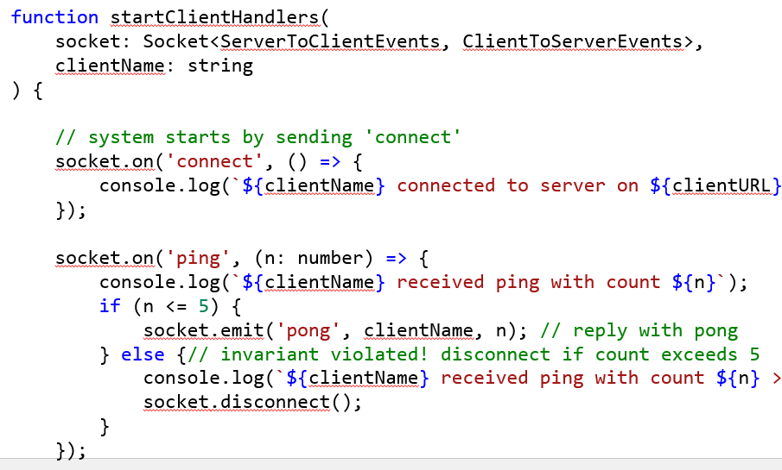
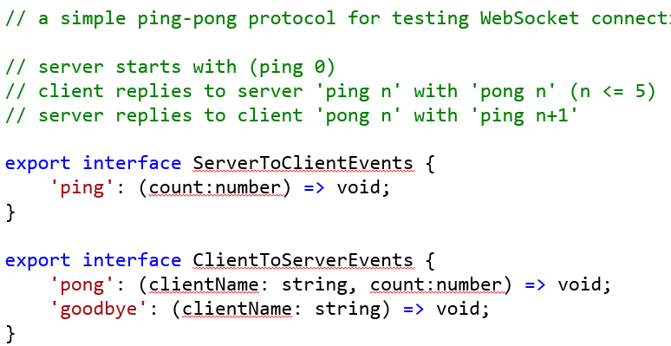
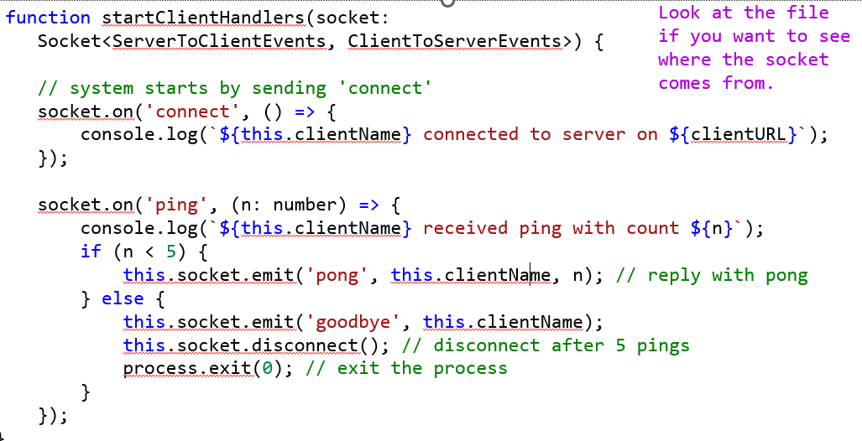
Choreographies and Projections
Choreography
Projections
Notes:
Here's some fancy vocabulary you can use to impress your boss:
A communications protocol like the one we've shown is sometimes called a 'choreography', and the implementations of the different agents are called its 'projections'.
There are tools that let you write out a choreography in machine-readable form, and will then generate projections automatically. (Remember our slogan: tools can probably do this better than you can!)

Slide 41
Review: Learning Goals for this Lesson
You should now be able to:
Explain how patterns capture common solutions and tradeoffs for recurring problems.
Explain and give an example of each of the following:
The Demand-Pull pattern
The Data-Push (aka Listener or Observer) pattern
The Callback or Handler pattern
The Typed-Emitter pattern
Notes:
<read slide>

